Slide 1
SPECGREEDY Unified Dense Subgraph Detection
Wenjie Feng⁺, Shenhua Liu⁺, Danai Koutra#, Huawei Shen⁺, Xueqi Cheng⁺
⁺Institute of Computing Technology, ICT, CAS
#University of Michigan, Ann Arbor

Slide 2
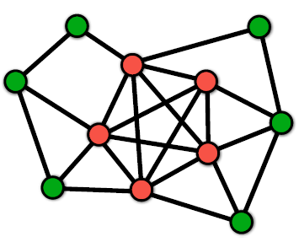
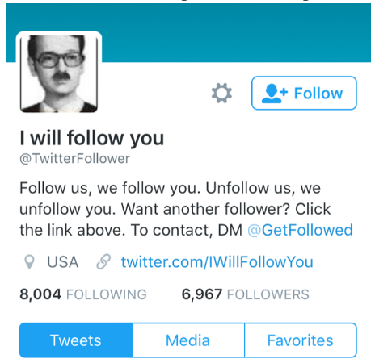
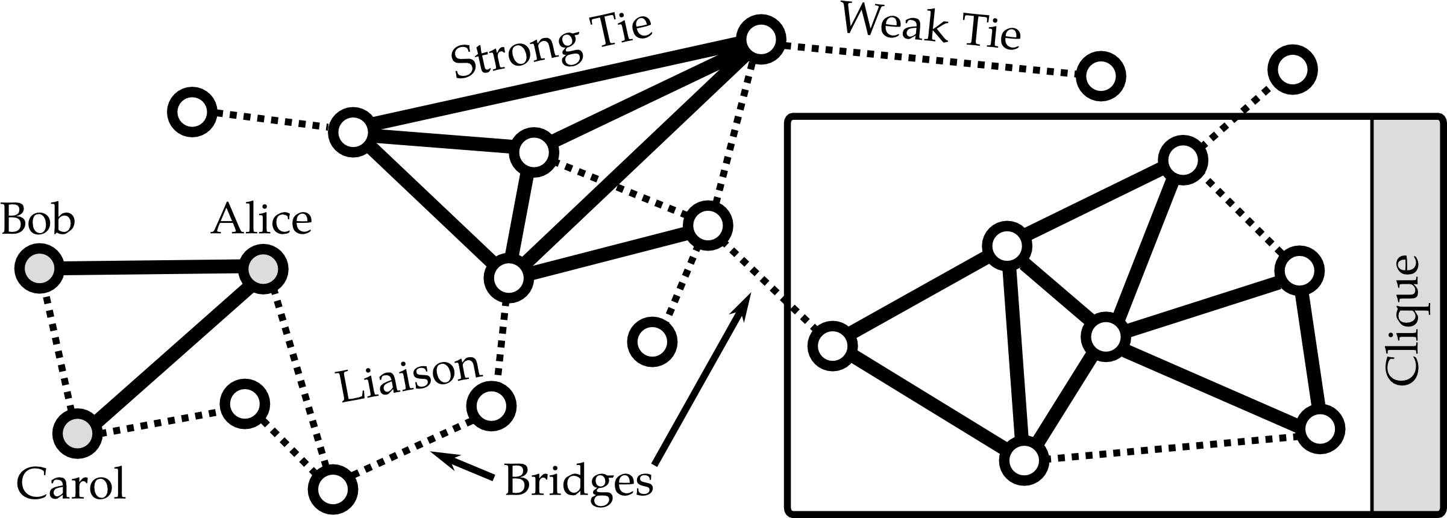
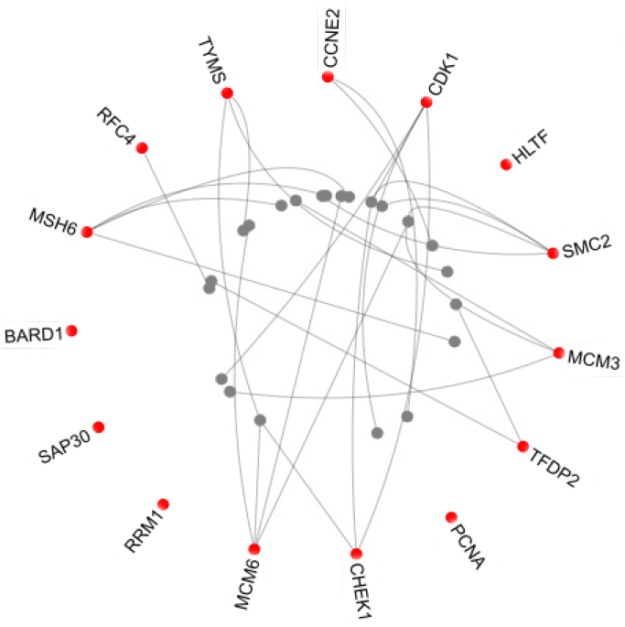
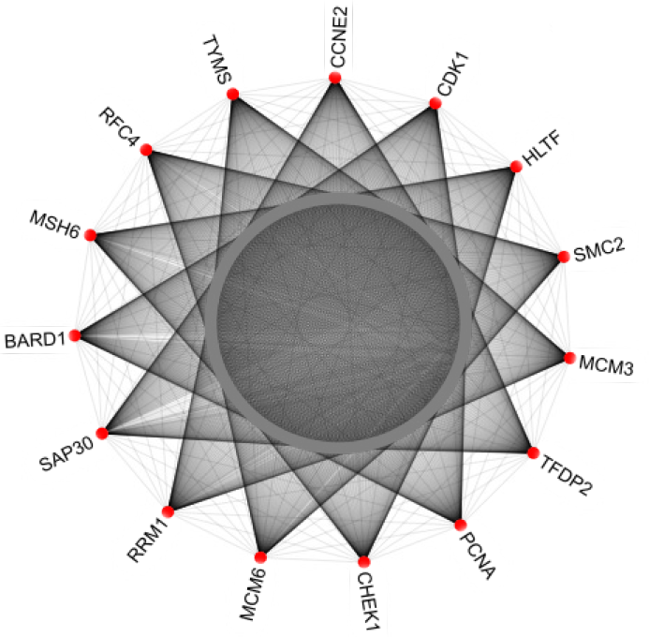
Motivation: Dense Subgraph Detection
Introduction
Proposed Method
Experiments
Conclusion
Ubiquitous applications
unified formalization
Densest subgraph
[Charikar M.’00]
Community detection
[Miyauchi A. et al’18]
Fraud detection
[B. Hooi et al’18]
News hot topics discovery
[LY, Chu et al’12]
Contrast dense subgraph
[Wong S. W e al’18]

Slide 3
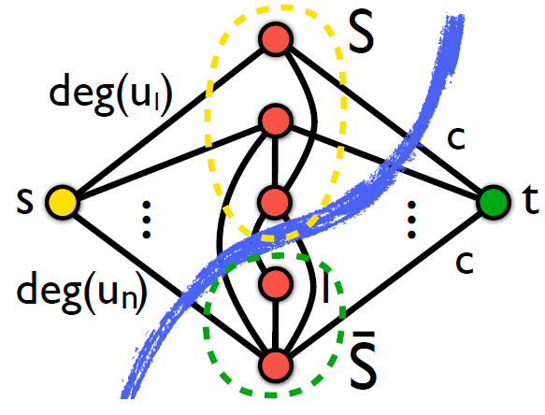
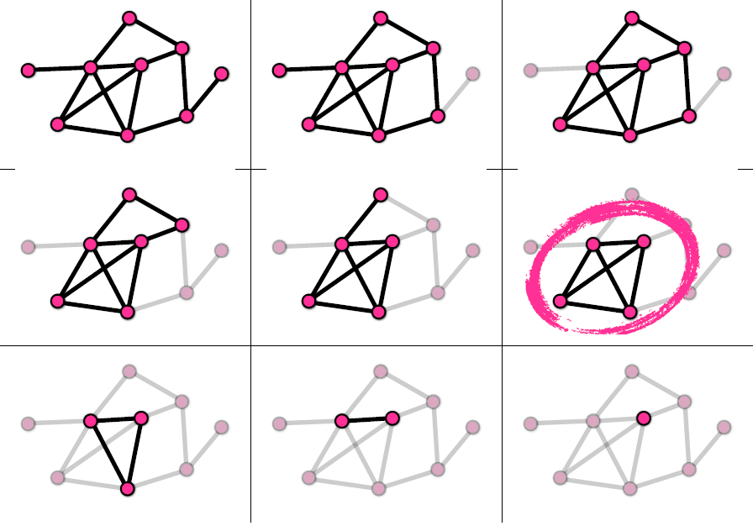
Motivation: Densest Subgraph Detection
Introduction
Proposed Method
Experiments
Conclusion
Polynomial-time methods
Exact solution: maximum flows based algo.
$O({\left|U\right|}^{2}+\left|U\right| ⋅|E|)$
Approx. solution: Greedy Peeling algo. ($1/2$-optimal)
$O\left(\left|E\right|⋅\log\left|U\right|\right)$
faster algorithm
Max-flow exact DS
[Goldberg’84]
Greedy approx. DS
[Charikar,M.’00]

Slide 4
How can we unify and fast detect those various different dense subgraph patterns in large graphs?

Slide 5
OVERVIEW-METHOD
GENDS: a unified problem framework
MinQuotientCut
[Chung RK. Fan’96]
SparseCutDS
[Miyauchi A. et al’18]
TempDS
[Wong S. W e al’18]
Fraudar
[B. Hooi et al’18]
Charikar
[Charikar M.’00]
Risk-averse DS
[C. E. Tsourakakis et al’19]

Slide 6
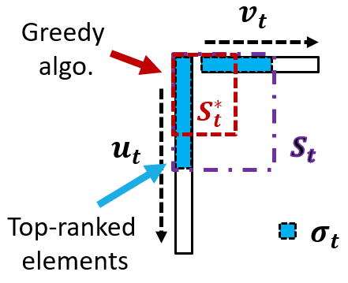
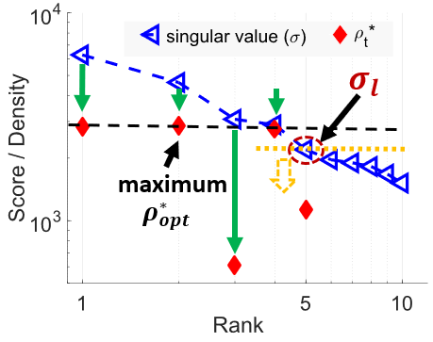
OVERVIEW-METHOD
SPECGREEDY: a unified detection algorithm
Graph spectral + Greedy approximation
Linearly scalable with the graph size

Slide 7
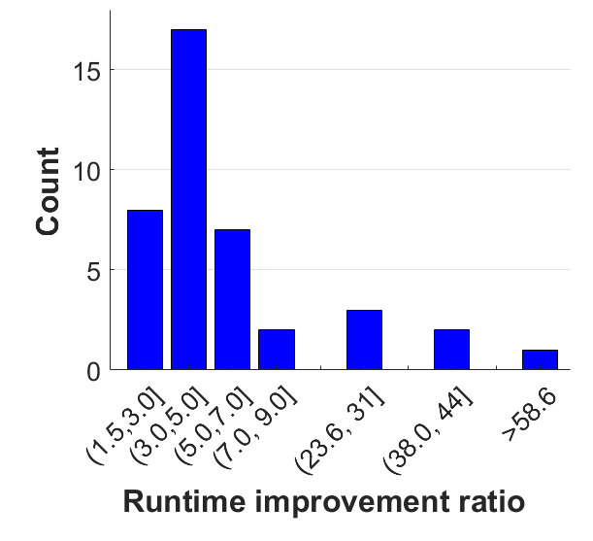
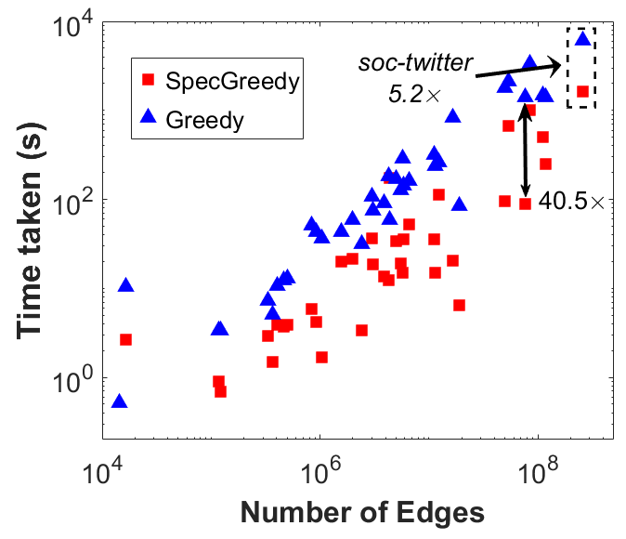
OVERVIEW-PERFORMANCE
SPECGREEDY is faster than Greedy algo.

Slide 8
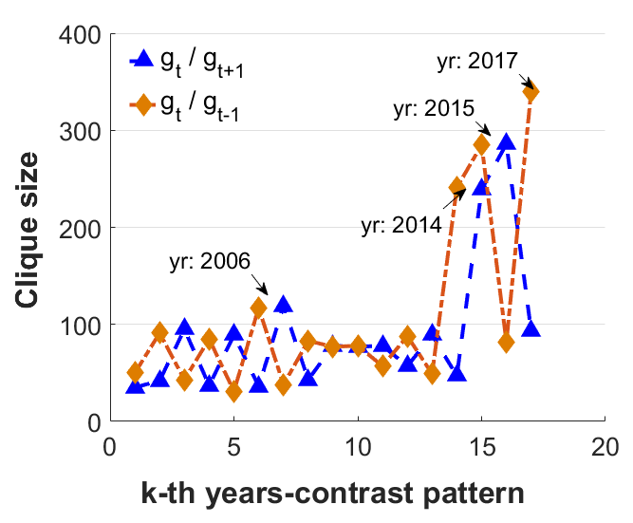
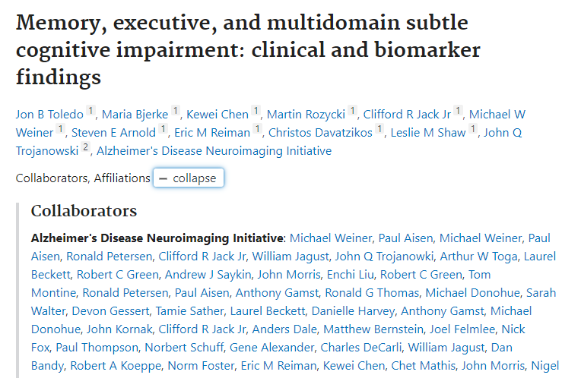
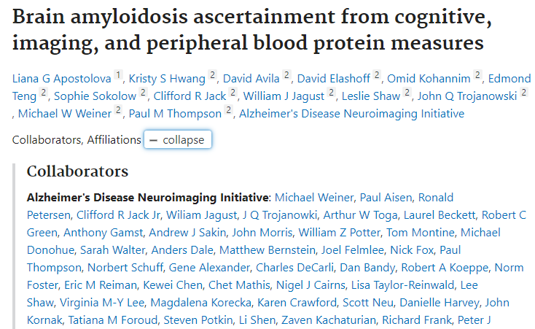
OVERVIEW-PERFORMANCE
Neurology & Medicine
Physics
Brain network and Disease
SPECGREEDY is effective, e.g. contrast dense subgraphs

Slide 9
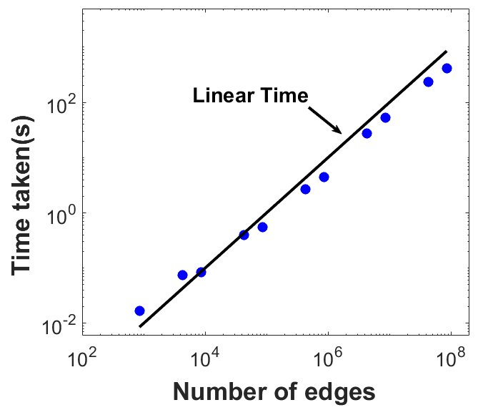
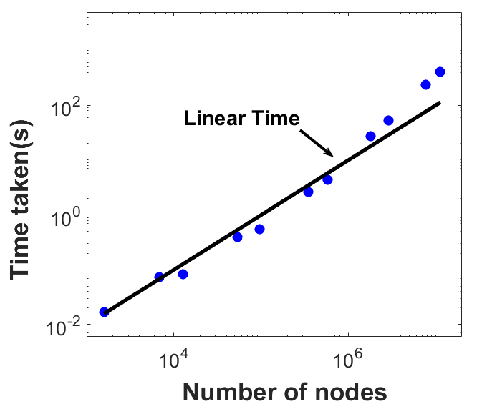
OVERVIEW-PERFORMANCE
SPECGREEDY is scalable

Slide 10
Road Map
Introduction
Proposed Method:
Unified Formulation: GENDS <<
Algorithm: SPECGREEDY
Experiments
Conclusion

Slide 11
GENDS: Unified Formulation
Introduction
Proposed Method
Experiments
Conclusion
GENDS: Generalized Dense Subgraph detection
Given:
$𝓖=(U, E)$ and its contrast $𝓖^{′}=\left(U, E^{′}\right)$
matrices $P=A+{2D}_{c}, Q=A^{′}+γI$ related to$𝒢$ and $𝒢^{′}$resp.
Find
the optimal subset $S^{∗}⊆U$,
$c_{i}$: node weight
$x$ is the indicator vector for the node subset

Slide 12
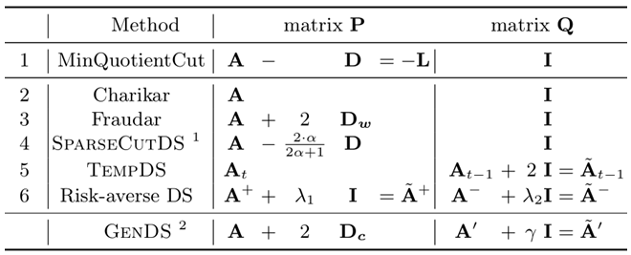
Problems Correspondence
Introduction
Proposed Method
Experiments
Conclusion
GENDS and some related instantiation problems
Graph at time t
Graph at time t-1,

Slide 13
Theoretical Analysis
Introduction
Proposed Method
Experiments
Conclusion
1. Graph spectral and Optimality
Generalized Rayleigh ratio (quadratic optimization)
Positive residual graph $𝓖_{r}$: $A_{r}={\left(P−Q\right)}^{+}$
$R\left(A_{r}, x\right)=\frac{x^{T}A_{r}x}{x^{T}x}$, $x∈ℝ^{n},x≠0$
Rayleigh-Ritz Theorem (real space)
$A_{r}=UΛU^{T}, Λ=diag\left(λ_{1}, ⋯λ_{n}\right)$
$A_{r}=UΣV^{T}$, $Σ=diag\left(σ_{1}, …,σ_{k}\right)$
$σ_{1}≥⋯≥σ_{k}≥0$
n
k
n
$$A_{r}$$
…
m
m
$$⋱$$
…

Slide 14
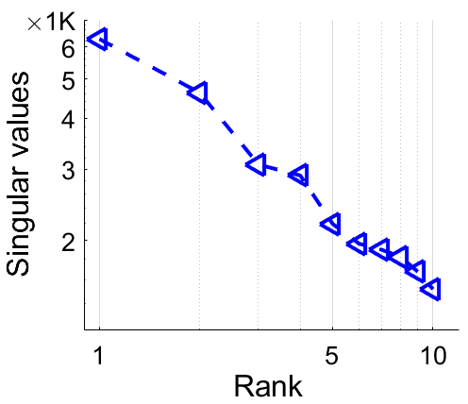
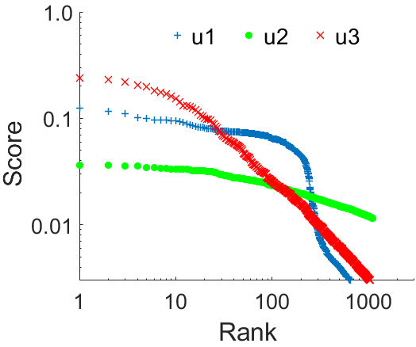
Theoretical Analysis (cont.)
Introduction
Proposed Method
Experiments
Conclusion
2. Properties of real-world large graphs
Sparse connection
Skew distributions (e.g., power-law)
degree, eigen/singular value, network values, |bipartite core| etc.
Singular values and score of singular vector elem. distribution of soc-twitter network

Slide 15
Theoretical Analysis: Optimal Solution
Introduction
Proposed Method
Experiments
Conclusion
GENDS solution for $𝓖_{r}$
The optimal density of subgraph of $S^{∗}$:
Important parts:
top singular values
top-ranked elements in singular vectors
$ρ_{opt}≤σ_{1}$

Slide 16
Road Map
Introduction
Proposed Method:
Unified Formulation: GENDS
Algorithm: SPECGREEDY <<
Experiments
Conclusion

Slide 17
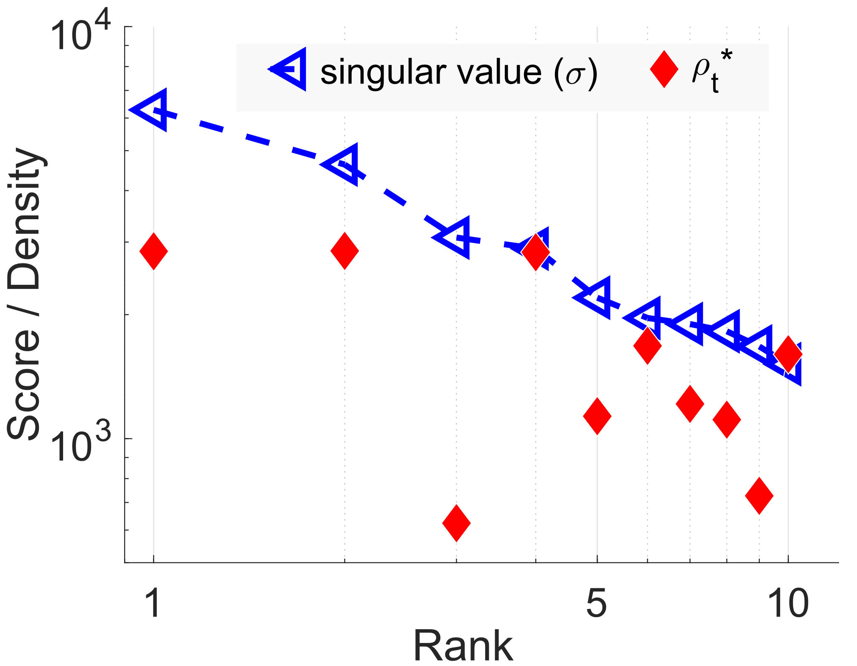
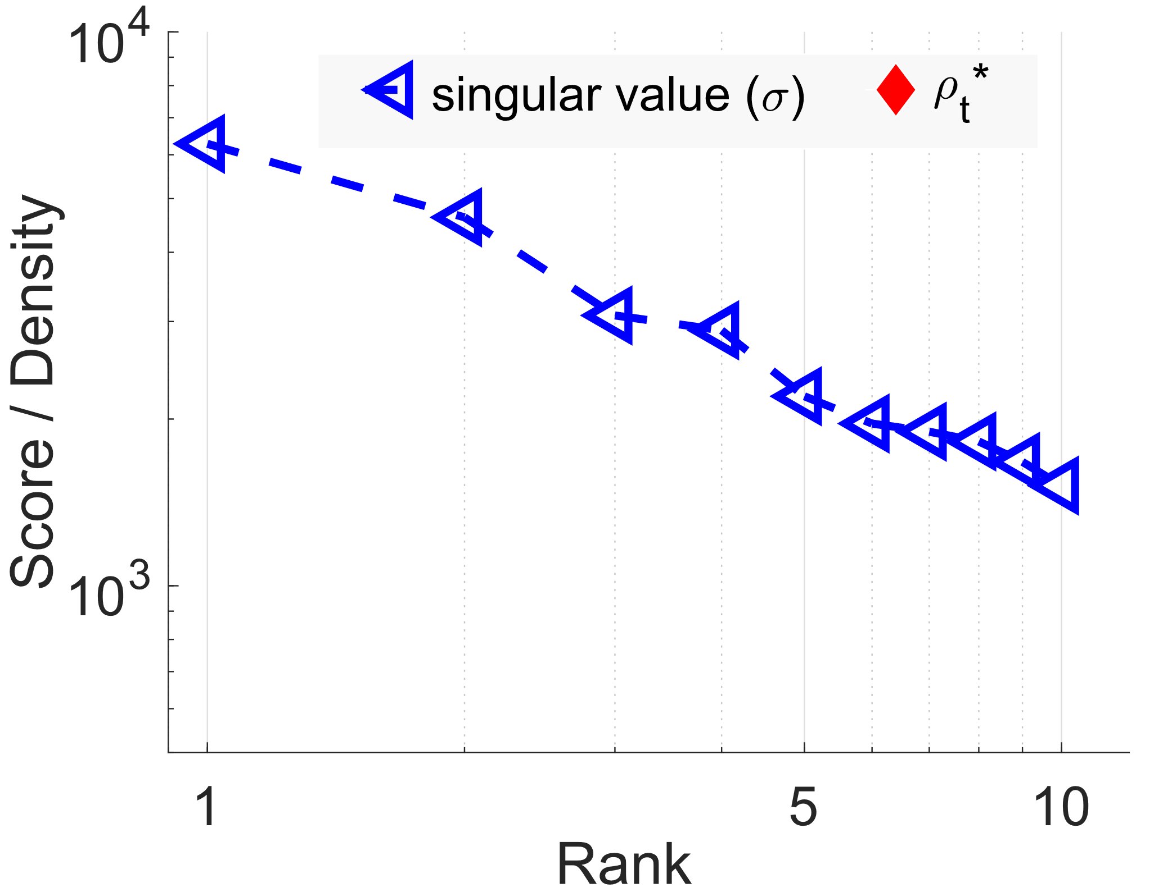
Approximate Optimal Solution
Introduction
Proposed Method
Experiments
Conclusion
$$v_{t}$$
Greedy
algo.
$S_{t}^{∗}$
$$σ_{l}$$
$$u_{t}$$
$$S_{t}$$
maximum
current
max
current
max
$$ρ_{opt}^{∗}$$
Top-ranked
elements
$$σ_{t}$$
Approximation solution $S_{t}^{∗}$:
$g_{t}$: subgraph for $S_{t}$ of the trunc. $t$-th top singular vectors ($u_{t}, v_{t}$)
$g_{t}^{∗}:$ the densest subgraph of $g_{t}$ with Greedy algo.
Density of $g_{t}^{∗}$: $ρ_{t}^{∗}≼σ_{t}$
$S_{opt}^{∗}$ approx. optimal solution for $𝓖_{r}$:
$$σ_{1}>⋯>ρ_{opt}^{∗}≽σ_{l}≥⋯$$

Slide 18
SPECGREEDY: Unified Detection Algorithm
Introduction
Proposed Method
Experiments
Conclusion
Graph spectral + Greedy peeling approx.
Main steps: ($k$: parameter for SVD approx.)
S0: construct positive residual graph $𝓖_{r}$
S1: $A_{r}$ SVD (top-$k$ low-rank approx.)
Repeat:
S2-1: Construct candidate $S_{t}$ for truncated ($u_{t}, v_{t}$)
S2-2: $S_{t}^{∗}$: densest subgraph with greedy detection for $S_{t}$
S2-3: Update current optimal density $ρ_{opt}^{∗}$ with $S_{t}^{∗}$ if needed
Until $ρ_{opt}^{∗}>σ_{t+1}$ or $t < k$
Return $𝓖_{r}$($S_{opt}^{∗}$)
S2

Slide 19
Road Map
Introduction
Proposed Method:
Unified Formulation: GENDS
Algorithm: SPECGREEDY
Experiments <<
Conclusion

Slide 20
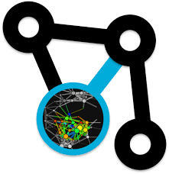
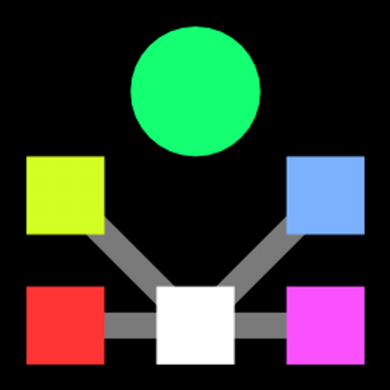
Experiments on 40 networks
Introduction
Proposed Method
Experiments
Conclusion
Baselines:
Greedy (Charikar)
SpokEn (SVD)
Parameter: $k=10$ for SPECGREEDY
Datasets:
40 real-world networks from 5 public dataset repos.
Stanford SNAP, Network Repository, AMiner scholar, ASU’ social computing, KONECT Network Collection

Slide 21
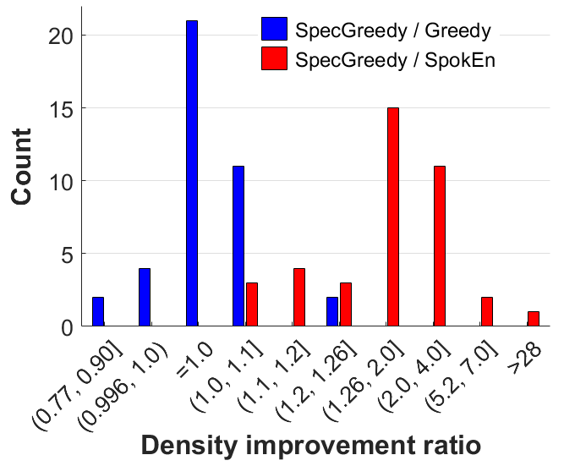
Exp1. Quality-Speed Test
Introduction
Proposed Method
Experiments
Conclusion
The density of the detected densest subgraph
$1.26×$ denser than Greedy
$77×$ denser than SpokEn

Slide 22
Exp1. Quality-Speed Test (cont.)
Introduction
Proposed Method
Experiments
Conclusion
The speed-up for detecting the densest subgraph
SpecGreedy vs. Greedy
$1.5−58.6×$ faster

Slide 23
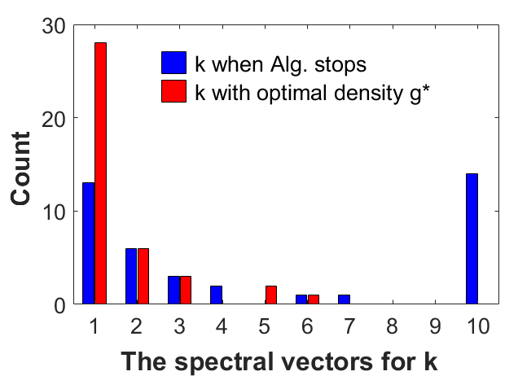
Exp2. Parameter Test
Introduction
Proposed Method
Experiments
Conclusion
Optimal graph spectral for the densest subgraph
Few top-k singular vectors for most networks
$$ρ$$
Algo. Parameter:
$k=10$

Slide 24
Exp3. Effectiveness Test
Introduction
Proposed Method
Experiments
Conclusion
Contrast dense subgraphs in dynamic graph
Neurology & Medicine
Physics
Brain network and Disease

Slide 25
Exp4. Scalability Test
Introduction
Proposed Method
Experiments
Conclusion
Time complexity: $O{\left(K⋅\left|E\right|+K⋅\left|E\left(\tilde{S}\right)\right|\log\left|\tilde{S}\right|\right)}^{1}$
Linear scalable with the size of the graph
$^{1}\tilde{S}$: max-size candidate $S_{t}$, $\left|\tilde{S}\right|≪|S|$

Slide 26
Experiments
Introduction
Proposed Method
Experiments
Conclusion
Properties of SPECGREEDY:
Faster: detects the high-quality the densest subgraphs faster than the Greedy algo.
Effective: detects the contrast dense subgraph pattern in scholar co-authorship
Scalable: runs linearly w.r.t graph size
0

Slide 27
Road Map
Introduction
Proposed Method:
Unified Formulation: GENDS
Algorithm: SPECGREEDY
Experiments
Conclusion <<

Slide 28
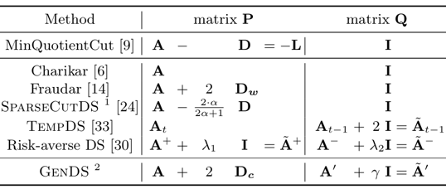
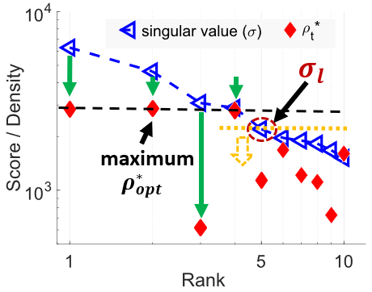
Summary
Introduction
Proposed Method
Experiments
Conclusion
SPECGREEDY: Unified Dense Subgraph Detection
Unified formulation (GenDS)
Graph spectral guaranty
Faster
Effective
Scalable

Slide 29
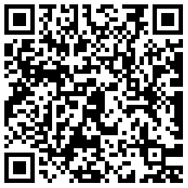
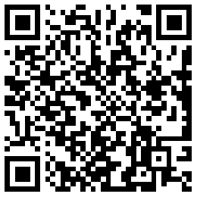
Thank You!
Visit our paper to learn more
papers
code
Questions:
wenchiehfeng.us@gmail.com

Slide 30
REFERENCE
Bryan Hooi, Hyun Ah Song, Alex Beutel, Neil Shah, Kijung Shin, and Christos Faloutsos. FRAUDAR: bounding graph fraud in the face of camouflage. KDD 2016.
C. E. Tsourakakis, T. Chen, N. Kakimura, and J. W. Pachocki. Novel dense subgraph discovery primitives: risk aversion and exclusion queries. ECML-PKDD, 2019.
Fan. R. K. Chung. Spectral graph theory[B]. American mathematical soc., 1996.
M. Charikar. Greedy approximation algorithms for finding dense components in a graph. In APPROX, 2000.
Miyauchi, Atsushi, and Naonori Kakimura. "Finding a dense subgraph with sparse cut.“, CIKM. 2018.
R. Andersen and K. Chellapilla. Finding dense subgraphs with size bounds. In WAW, 2009.
S. Liu, B. Hooi, and C. Faloutsos. A contrast metric for fraud detection in rich graphs. TKDE, 2018.
Y. Yang, L. Chu, Y. Zhang, Z. Wang, J. Pei, and E. Chen. Mining density contrast subgraphs. In ICDE, IEEE, 2018.
Y. Asahiro, K. Iwama, H. Tamaki, and T. Tokuyama. Greedily finding a dense subgraph. Journal of Algorithms, 2000.

