Slide 1
Catching Hierarchical Dense Subtensor
CatchCore:
Wenjie Feng, Shenghua Liu, Huawei Shen, Xueqi Cheng
Institute of Computing Technology ICT, CAS
University of Chines Academy of Sciences, UCAS

Slide 2
Motivation: Anomaly in Tensors
Multi-aspect data (tensor) in real-word application
Dense blocks signal for pattern / anomaly / fraud
Timestamp
Timestamp
Timestamp
Target IP
Author
Tweets
Source IP
Author
Src User
TCP Dumps
Research Co-author
Social Network
Attack
Cooperation Group
Fraudster

Slide 3
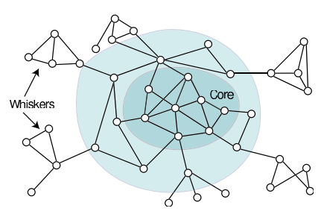
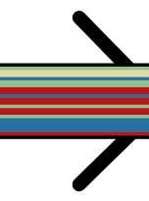
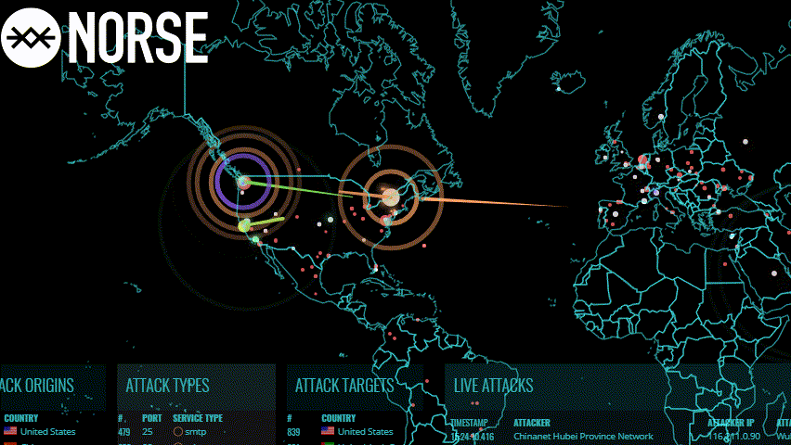
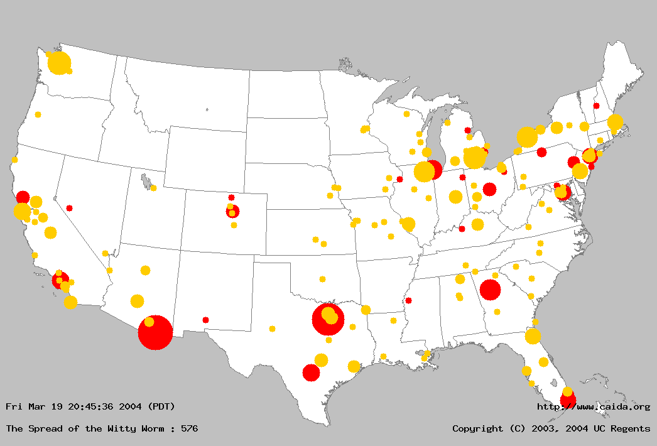
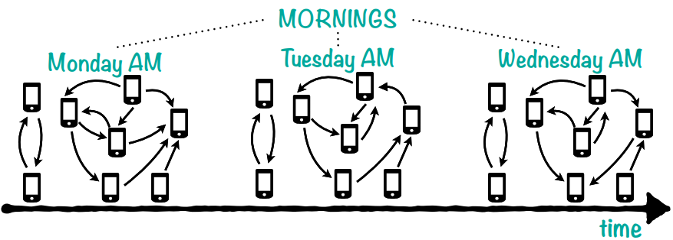
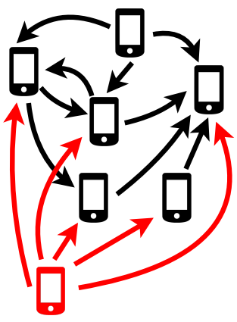
Motivation: Hierarchical Structure
Static structure and Dynamic scenario
Community & Core–Periphery
[Daniel Edler et al, 2017], [Jure etal 2008]
Cyber threat
Real-Time Map
Witty Worm spread
Evolving patterns
Notes:
Ref: Mapping higher-order network flows in memory and multilayer networks with Infomap

Slide 4
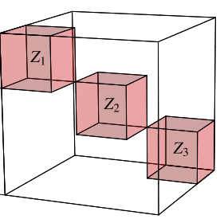
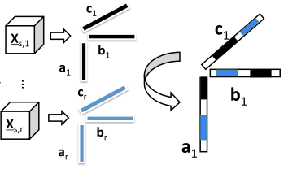
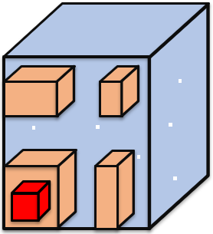
Research Question
Previous methods assume that blocks are exclusive and detect in a flat manner. (No subtle structure & relations)
M-Zoom [kijung et al. ‘16], D-Cube [kijung et al. ‘17]
CrossSpot [Jiang et al. ‘15]
CP-Decomp, MAF [Maruhashi et al. ‘11]
Question:
Given a large-scale high-order tensor, how can we detect hierarchical dense sub-structure (sub-block / tensor) ?

Slide 5
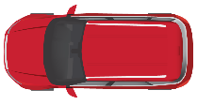
Road Map
Motivation
Proposed Method: CatchCore
Terminologies and Problem definition <<
Algorithm
Experiments
Conclusion

Slide 6
Terminologies
Assume a block (subtensor) $𝓑$ in a tensor $𝓡$
Tensor inclusion : $𝓑≼𝓑$
$M_{𝓑}=Mass(𝓑)$: (sum of entries)
$V_{𝓑}=Volume(𝓑)$: $I_{1}×I_{2}×⋯×I_{n}$
$D_{𝓑}=Cadinalties(𝓑)$: $I_{1}+I_{2}+⋯+I_{n}$
$$𝓡$$
$$I_{3}$$
$$I_{2}$$
$$𝓑$$
$$I_{1}$$
3-way tensor example

Slide 7
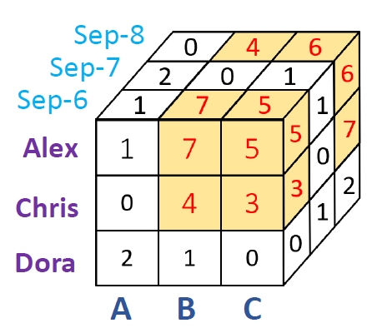
Terminologies (cont.)
Indicator vectors based formulation for subtensor
$×_{n}$: n-mode product
Date
Indicator Vector Paradigm
User
Item

Slide 8
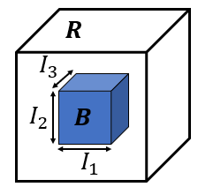
Density Terminology
$M_{B}$: mass
$V_{B}$ : volume
$D_{B}$: card.
Common density metrics
Volume Density:
${f_{B}=M_{B}}/{V_{B}}$ $⇒$ $\ln{f_{B}}=\ln{M_{B}}−\ln{V_{B}}$
Arithmetic Avg. Degree:
${f_{B}=M_{B}}/{(D_{B}/N})$ $⇒$ $\ln{f_{B}}=\ln{M_{B}}−\ln{D_{B}}−c$
Geometric Avg. Degree:
$f_{B}={M_{B}}/{\sqrt[N]{V_{B}}}$ $⇒$ $\ln{f_{B}}=\ln{M_{B}}−\frac{1}{N}\ln{V_{B}}$
Entry-Plenum metric
$M_{X},$ $S_{X}$: mass and size (vol. /card.) of subtensor $X$

Slide 9
Problem Definition I
Densest ($g, h, φ$)-entry-plenum Subtensor Detection
Given: (1).$𝓡$: N-way tensor (2).$φ$: constant factor (3).$g, h$: two increasing functions
Find: an indicator vectors collection $X^{∗}$,

Slide 10
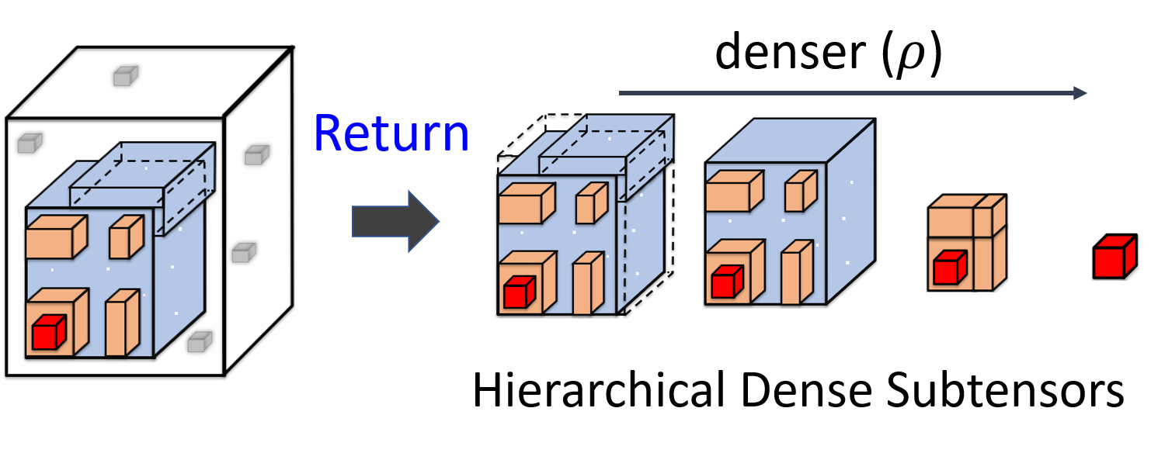
Hierarchical Dense Subtensors
For subtensors , in two adjacent hierarches
Density: Significantly Different (Diversity)
Structure: multi-layer cores (Close-knit)

Slide 11
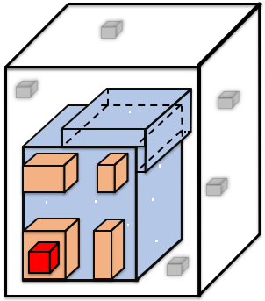
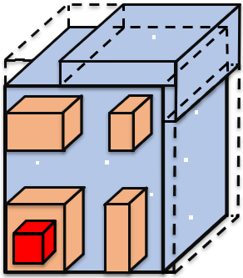
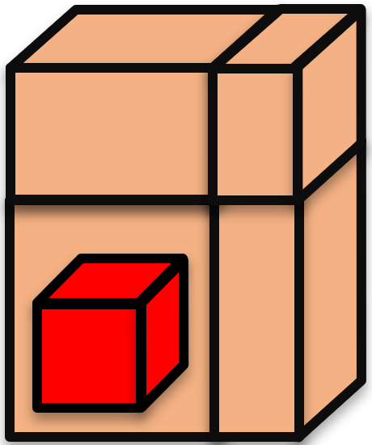
Problem Definition II
Hierarchical Dense Subtensors Detection
Given: (1).$𝓡$: N-way tensor (2).$η$: density ratio (3).$K$: the max #hierarchies
Find: $r$ ($≤$ K) significant hierarchical dense subtensors {$X^{1}, X^{2}, …, X^{r}$}
$$(R=$$
$$,η=η_{p},K=4)$$
$$\{$$
$$\}$$
$$,$$
$$,$$
$$,$$
$$,$$

Slide 12
Requirements
Our goal is to design an algorithm to be
CatchCore, our proposed method, satisfies all the requirements
Accurate: provides an accurate detection
Effective: produces meaningful results / patterns.
Stable: unsensitive for parameters, more flexible for various density metrics
Scalable: runs in near-linear time
0

Slide 13
Road Map
Motivation
Proposed Method: CatchCore
Terminologies and Problem definition
Algorithm <<
Experiments
Conclusion

Slide 14
Optimization instantiation
($g, h, φ$)-Entry-Plenum instantiation:
Densest subtensor detection:
$$ℱ_{φ}\left(X\right)=g\left(M_{X}\right)−φ⋅h\left(S_{X}\right)$$
$g\left(x\right)=h\left(x\right)=x$, $φ=\frac{p}{1+p}$, $S_{X}=V_{X}$

Slide 15
Optimization instantiation (cont.)
Interpretable instantiation (densest subtensor)
Maximize the mass of entries in subtensor
Minimize the mass of missing entries (penalize)
$$−p$$
$$−p$$
0 | 1 | 0
0 | 1 | 1
1 | 1 | 1
$$−p$$

Slide 16
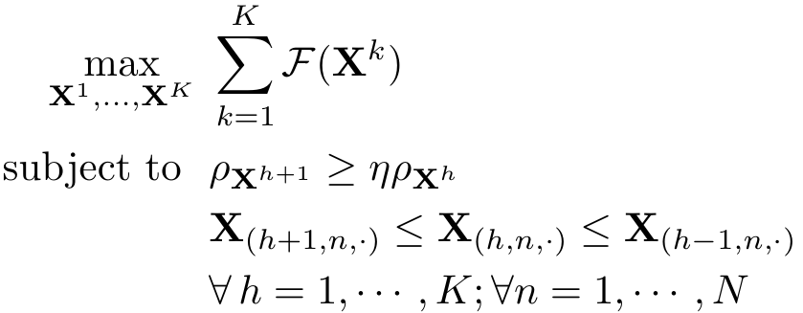
HDS-tensors detection
To detect K hierarchical dense subtensors
Integer programming (NP-hard)
Bound-constrained Multi-Variable Non-Linear
Relaxation:
To linear programming (LP):
Density constraints:
Volume density ${ρ_{B}{= M}_{B}}/{V_{B}}$

Slide 17
HDS-tensors detection (cont.)
Objective function

Slide 18
Detail of CatchCore
Gradient Optimization Algorithm
Alternative Gauss-Seidel for updating
Procedure:
S0: Random Initialization (probability)
Repeat until convergency:
S1: Update for each hierarchy:
S2: Projected update with gradient descent for each dimension
S3: Select the top $r$ significant subtensors

Slide 19
Detail of CatchCore (cont.)
Details
Dimensional gradient-based update
1 0.45
1 0 1
1 0
1 0 1
3 1
6 1
2 0 0
3 1
6 1
2 0 0
1
1
0.75
0
0
1
1
0.75
0
0
1 | 1 | 0.8
1 | 1 | 0.8

Slide 20
Detail of CatchCore (cont.)
Details
Hierarchies gradient-based update
1 0 1
1 0 1
3 1
6 1
2 0 0
3 1
6 1
2 0 0
0
0
0
0
k hierarchies
k+1 hierarchies

Slide 21
Parameter Evaluation
Evaluate the quality of detection result of given parameter configuration
Measure: Minimum Description Length (MDL)
Given data $D$, model $M$
$L\left(D\right)=L\left(M\right)+L\left(D | M\right)$
$M^{∗}=argmin L\left(D\right)$

Slide 22
Road Map
Motivation
Proposed Method: CatchCore
Experiments <<
Conclusion

Slide 23
Exp1. Accuracy Test
Goal: compare the accuracy of dense-block detection methods
Baselines:
M-Zoom [Kijung et al. ’16]: Multi-dimensional Zoom
D-Cube [Kijung et al. ’17]: Disk-based Dense-block Detection
CrossSpot [Jiang et al. ’15]: Local Search Method
CPD: Tensor CP Decomposition

Slide 24
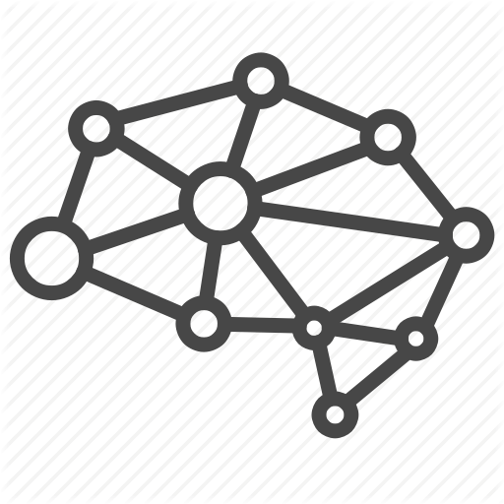
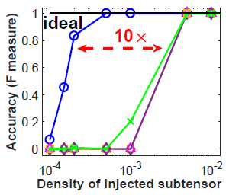
Exp1. Accuracy Test (cont.)
Synthetic data for single dense block detection
Tensor size: 5K X 5K X 5K
Injected blocks with varying density
Size: 200 X 300 X 100
CatchCore achieves lower detection bound (10× less density)

Slide 25
Exp1. Accuracy Test (cont.)
Data: Beer Review (User X Beer X Timestamp)
Injected hierarchical dense subtensors detection
CatchCore Wins
Methods:
Density & Shape:

Slide 26
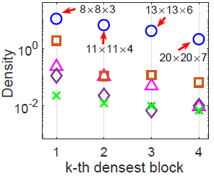
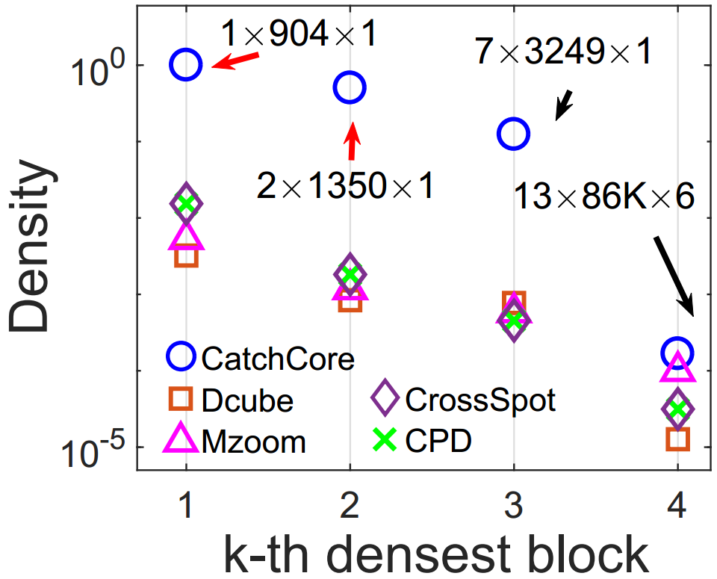
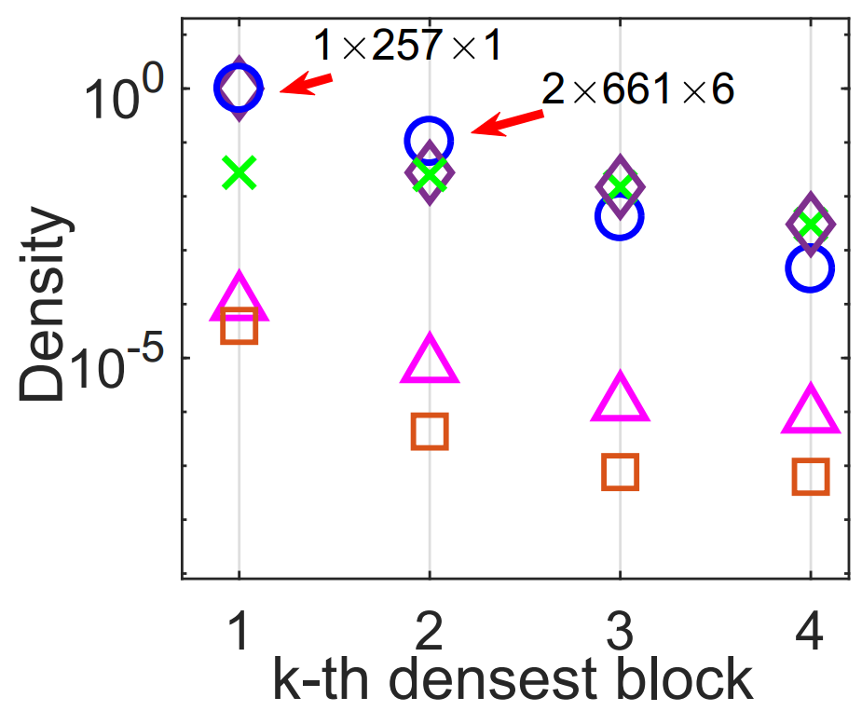
Exp1. Accuracy Test (cont.)
Hierarchical dense subtensors in real-world data
CatchCore detects denser subtensors (hierarchical)

Slide 27
Exp1. Accuracy Test
CatchCore shows higher accuracy for single and hierarchical dense blocks detection
Properties of CatchCore:
Accurate: provides an accurate detection
Effective: produces meaningful results, i.e., anomalies, periodical intrusion, research group.
Stable: unsensitive for parameters, more flexible for various density metrics
Scalable: runs in (sub-)linear time
0

Slide 28
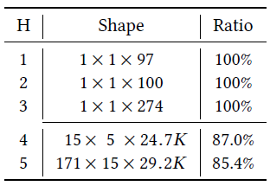
Exp2. Discovery in Practice
In TCP Dumps, CatchCore detects network attacks with higher accuracy.
Top five blocks found by CatchCore
7-way tensor
(duration X protocol X service X …)
3-way tensor
(srcIPs X tarIPs X Timestamps)

Slide 29
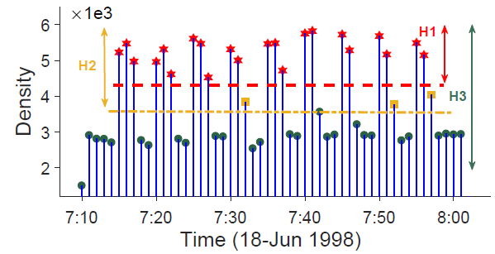
Exp2. Discovery in Practice (cont.)
CatchCore detects cyclic pattern of Neptune network intrusion for DARPA.
Top three blocks found by CatchCore
Neptune Attack
A (srcIP, destIP) pair conducts various intensity attack in a 5-minute cycle.

Slide 30
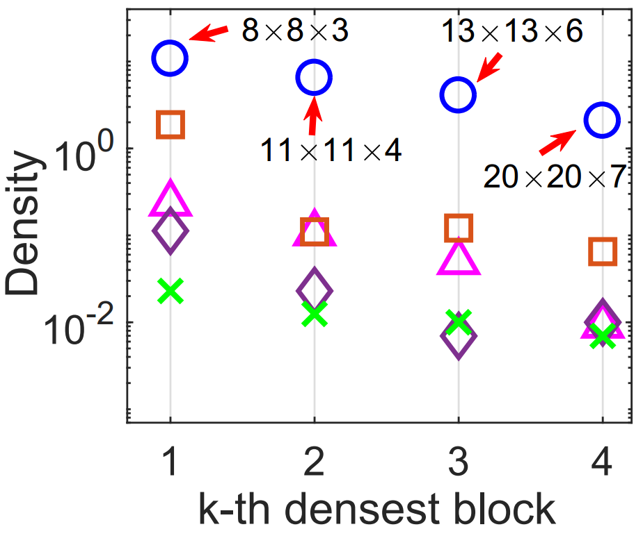
Exp2. Discovery in Practice (cont.)
In DBLP co-authorship network
(Authors X Authors X Years)
Top four blocks found by different methods
H | Density
1 | 10.74
2 | 6.48
3 | 4.07
4 | 2.08

Slide 31
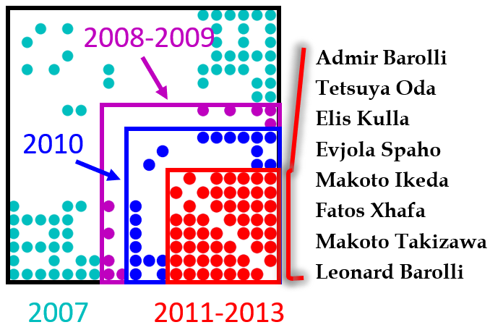
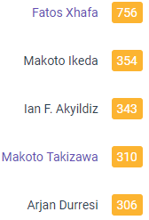
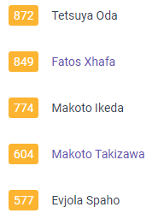
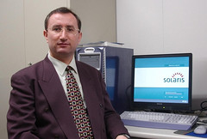
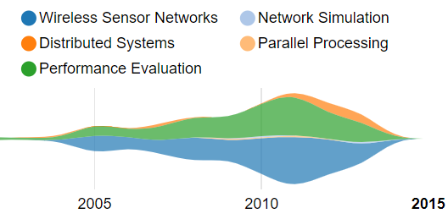
Exp2. Discovery in Practice (cont.)
In DBLP co-authorship network, CatchCore detects evolving co-author research community (20 users)
Avg.=10.74
Genetic Alg., Dist./Para./Grid Computing, P2P, Wireless

Slide 32
Exp2. Discovery in Practice (cont.)
In Youtube friends network
(Users X Users X Timestamps)
Top four blocks found by different methods
1st user became friend with 904 users within 1 hour

Slide 33
Exp2. Discovery in Practice (cont.)
In Youtube friends network, CatchCore detects denser blocks and suspicious bot activities.
First block found by CatchCore
1st user became friend with 904 users within 1 hour

Slide 34
Exp2. Discovery in Practice
CatchCore detects interesting patterns, e.g., attacks, co-author communities, etc.
Properties of CatchCore:
Accurate: provides an accurate detection
Effective: produces meaningful results, i.e., anomalies, periodical intrusion, research group.
Stable: unsensitive for parameters, more flexible for various density metrics
Scalable: runs in (sub-)linear time
0

Slide 35
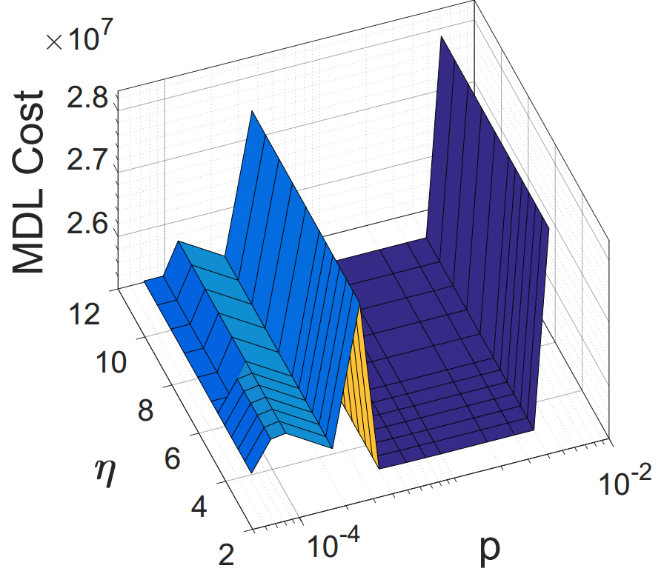
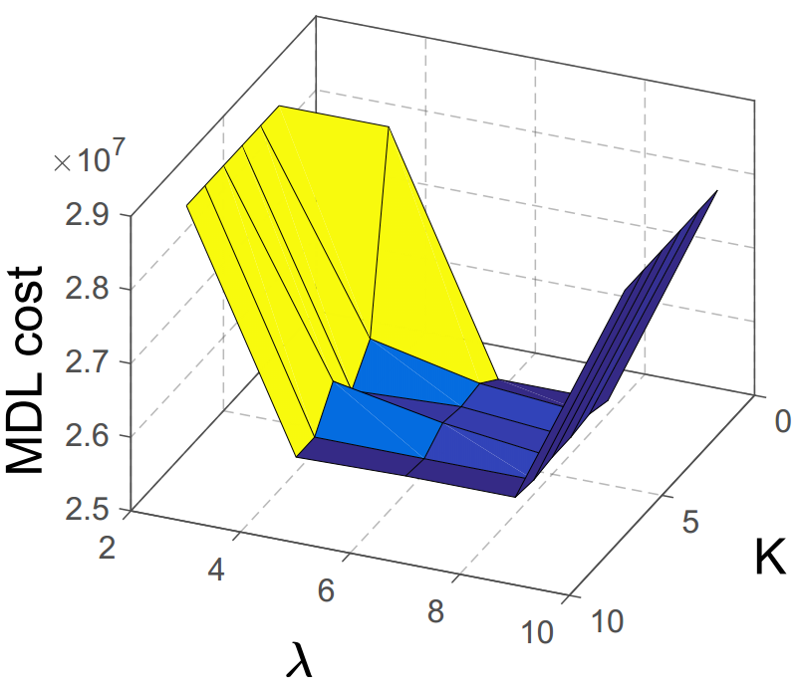
Exp3. Robustness Test
Quality of detection result with different param.
density ratio
max # hierarchies
missing entry penalty
Lagrange multiplier
CatchCore achieves the optimal solution for wide parameters range

Slide 36
Exp3. Robustness Test
CatchCore is robust with parameters and flexible to adapt to various density metrics.
Properties of CatchCore:
Accurate: provides an accurate detection
Effective: produces meaningful results, i.e., anomalies, periodical intrusion, research group.
Stable: unsensitive for parameters, more flexible for various density metrics
Scalable: runs in (sub)-linear time
0

Slide 37
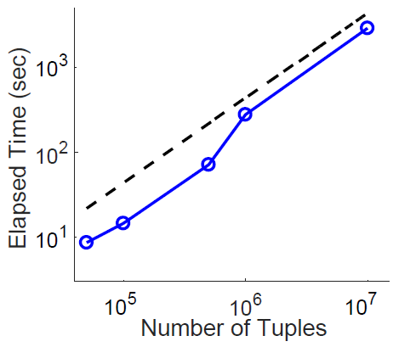
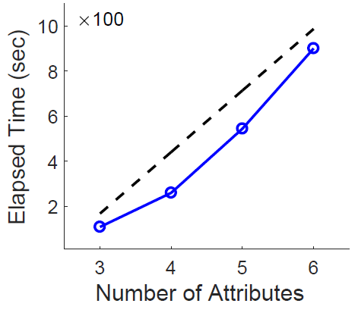
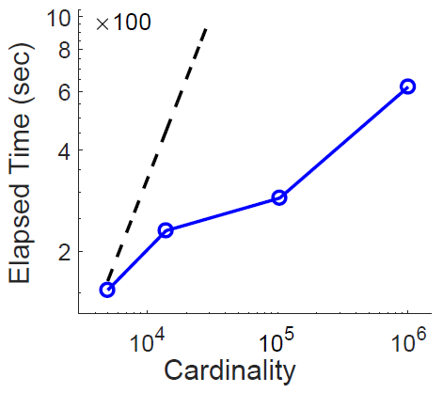
Exp4. Scalability Test
CatchCore is (sub-) linear in all aspects of tensor

Slide 38
Exp4. Scalability Test
CatchCore scales linearly with each input factor
Properties of CatchCore:
Accurate: provides an accurate detection
Effective: produces meaningful results, i.e., anomalies, periodical intrusion, research group.
Stable: unsensitive for parameters, more flexible for various density metrics
Scalable: runs in near-linear time
0

Slide 39
Road Map
Motivation
Proposed Method: CatchCore
Experiments
Conclusion <<

Slide 40
Conclusion
CatchCore:
Hierarchical Dense Subtensor Detection
Accurate
Scalable
Robust
Effective
Reproducible
https://github.com/wenchieh/catchcore

Slide 41
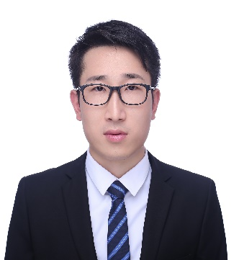
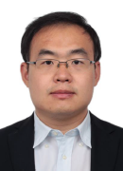
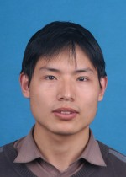
Thank you !
Source codes and datasets used in the paper are available at https://github.com/wenchieh/catchcore
Notes:
Ok, thank you for your listening.

